Slide 1

Capstone Project with Spinnaker Analytics
Team A6
Kaiyu Wang, Simeng Li,
Xiangshan Mu, Yihan Jia, Yinghao Wang

Slide 2





Our Group Members
Kaiyu Wang
Simeng Li
Xiangshan Mu
Yihan Jia
Yinghao Wang

Slide 3
Table of Contents
01
02
03
04
05
06
07
Project
Introduction
Data
Process
Exploratory
Data Analysis
Model
Options
Time Series Analysis
Classification Models
Use-Case Scenario

Slide 4
01 Introduction
Overview of our analysis

Slide 5

About the Dataset
The dataset contains sectoral data for 3 separate types of investments made in the US. It represents 60-70% of activity in the overall asset classes for that week. The weekly data spans 10 years from 2006 through end-Jan 2017.
Institutional Mutual Fund Holdings (IMF)
For institutional
Retail Mutual Fund Holdings (RMF)
For individual
Exchange Traded Funds (ETF)
The convenience of trading is available at any time during the day.

Slide 6
Data Fields Description
ReportDate: Weekly data aggregated and released every Wednesday
AssetClass: Industry/Sector/Asset Class
Industry: 20 industries for each type of fund (3 types of funds)
Sector: North America-USA-North America (one value for all)
Asset Class: Equity (one value for all)
Flow: Amount of positive (inflow) or negative (outflow) in Millions of USD
FlowPct: Flows as percent of assets at beginning of the week
AssetsEnd: Assets at end of the week in Millions of USD
PortfolioChangePct: Percent change in overall portfolio during the week
Notes:
1. intuitively shows dollar amount of value of a given fund
2. other attributes have factors outside the dataset that influence the value
All observations come from the same sector and asset class.

Slide 7
Project Overview
Business Objective:
find a tradable signal in the dataset
Our Tradable Signal:
Time Series Models: Use Flow as output label
Classification Models: Use self-calculated label: Recalculated Monthly Flow Change in Percentage, and put it into different range buckets.

Slide 8
Business Application
Fund traders, mutual funds, investors and security analysts all want a way to predict fund price fluctuations.
Anticipating the fluctuations of fund prices (up or down) and tradable signals in advance can help fund traders make better investment decisions.
We can also make recommendations based on long term, short term, different client needs and fund types.
Notes:
EX.if the flow is predicted to be increase and potentially reach the peak in the future 2 weeks, we can suggest clients to sell it on that time for more profits

Slide 9
02
Data Pre-processing
Basic Data Cleaning and Processing

Slide 10
Data Cleaning
Datasets
Concatenation
Drop
Useless Features
Extract
Year and Month
Concat three datasets into one dataframe for further analysis
Add one “Type” feature to recognize category
All the Asset and Sector values are the same, we only keep Industry
We extract year and month from date for further EDA and classification model compiling
Notes:
1. intuitively shows dollar amount of value of a given fund
2. other attributes have factors outside the dataset that influence the value
All observations come from the same sector and asset class.

Slide 11
03
Exploratory
Data Analysis
Help detect obvious errors, identify outliers,
understand relationships,
find patterns within data, and provide new insights.

Slide 12
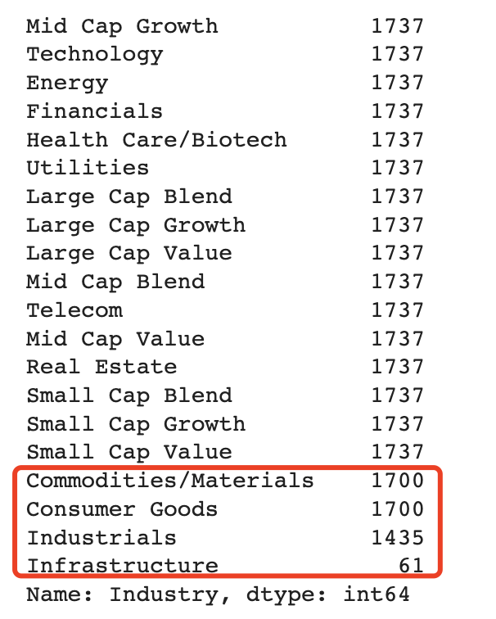
Some Industries Have Fewer Observations
There are four industries have missing observations during ten years’ recording.
We want to further analyze on these industry to understand:
Whether certain type of fund has fewer records than the others;
Where to start with missing data: at the very beginning, at the end, or discontinuity with no pattern.
Notes:
EX.if the flow is predicted to be increase and potentially reach the peak in the future 2 weeks, we can suggest clients to sell it on that time for more profits

Slide 13
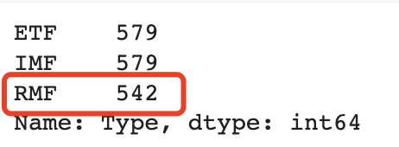
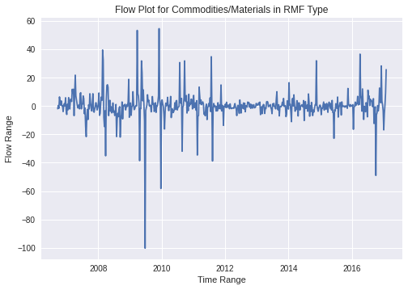
Commodities/Materials & Consumer Goods
Beginning of RMF Records is 37 Weeks Later Than The Other Two
RMF type of fund has a later beginning than the other two:
First record is on “2006-09-20”,
While the other two is on “2006-01-04”.
Difference in weeks between first record of types match with number of missing value.
There is no other discontinuity exists

Slide 14
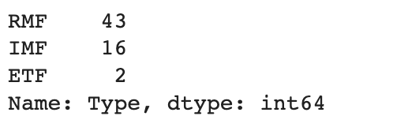
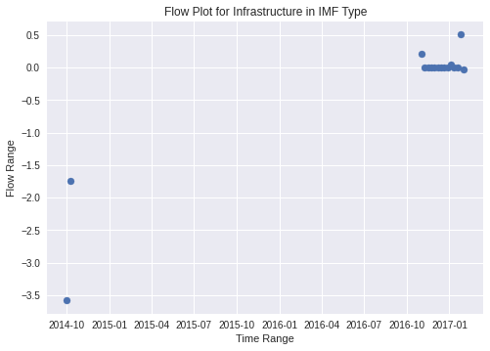
Infrastructure Industry
Too Few Records in Each Type
Number of observations in each type is less than 1 year.
Infrastructure industry has a recent start for RMF and IMF:
RMF: the first record is on “2016-04-13”;
IMF: the first record is on “2014-10-01”.
Two records of ETF all on 2014, only for 2 weeks.
There also exists discontinuity in IMF type.
⇒ Our decision:
This industry is not considered in the subsequent
modeling of predicting tradable signals.

Slide 15
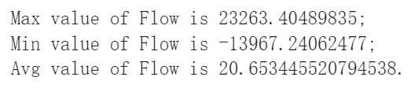
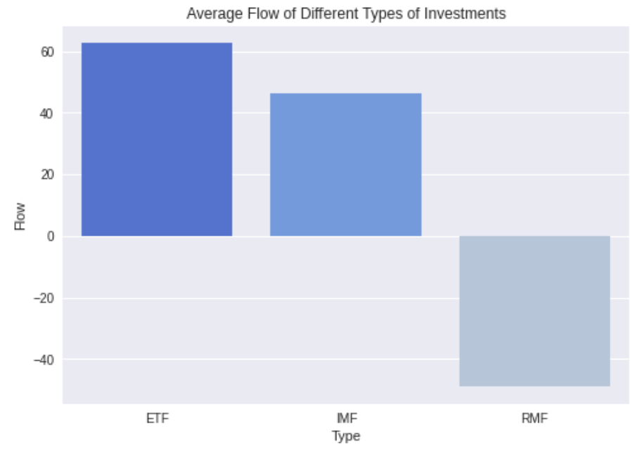
Average Flow among Different Types - ETF Funds Have the Largest Average Flow
The average flow of ETF funds is the largest.
The average flow of both ETF and IMF funds is greater than the overall average flow.

Slide 16
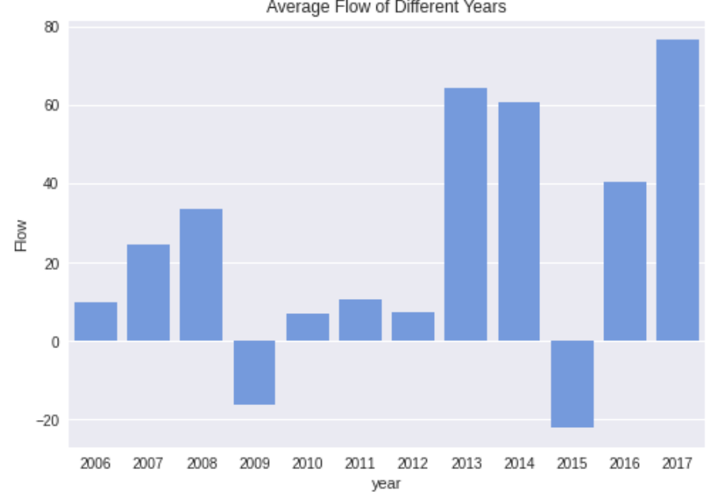
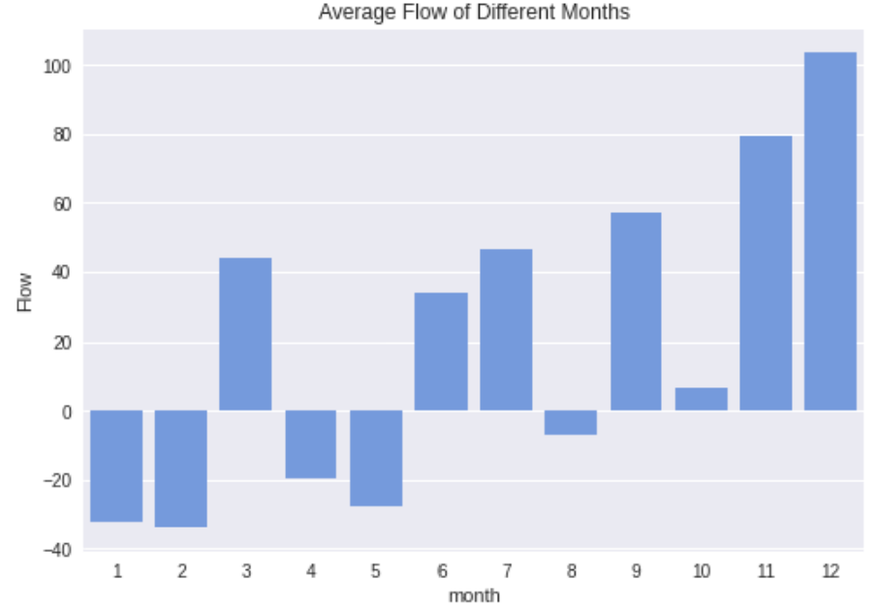
Average Flow among Different Years & Months
More Inflows in the Second Half of 2013 - 2017
Most of the positive average flow concentrated in the second half of the year.
Most of the funds flowed out in
the first half of the year and flowed in in
the second half of the year.
Average flows are very high from 2013 to 2017, except for 2015.
Average flows in 2009 and 2015 were negative and we'd guess more money was withdrawn.

Slide 17
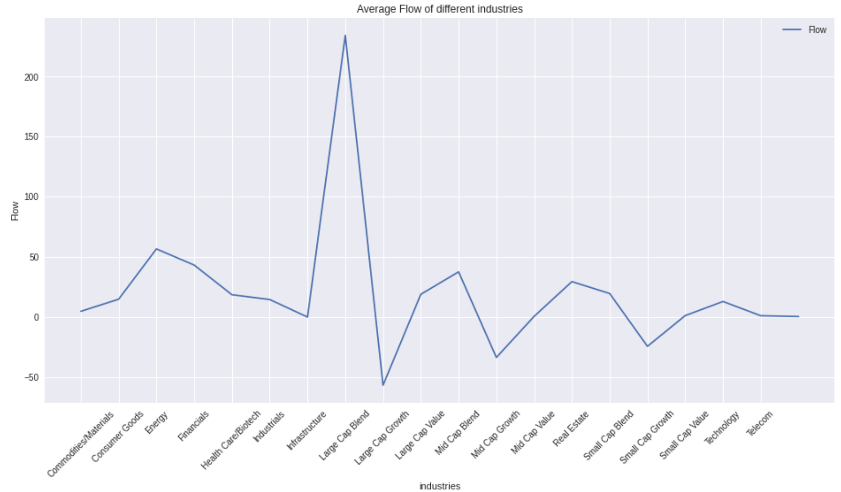
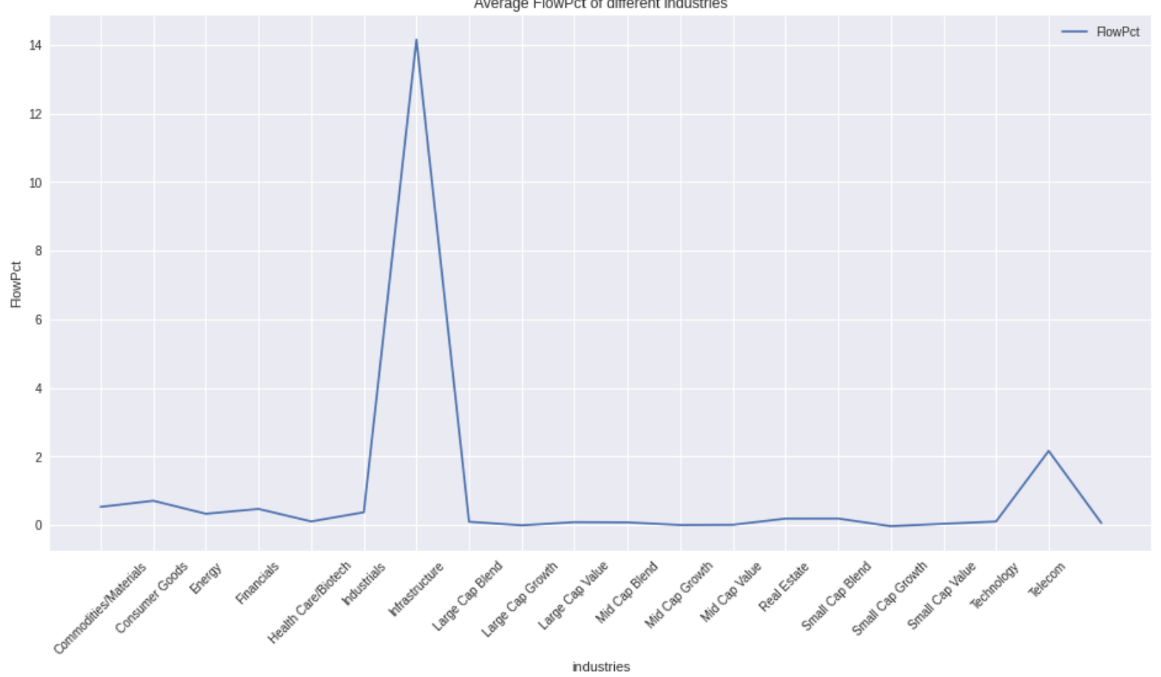
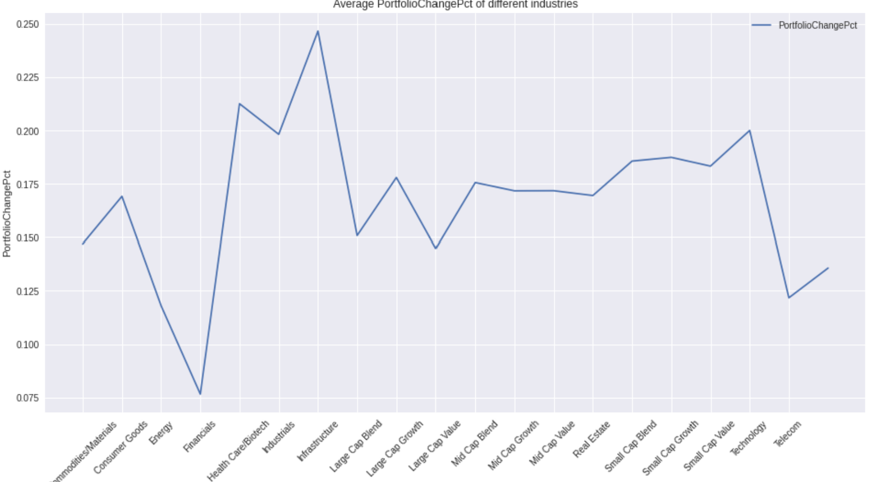
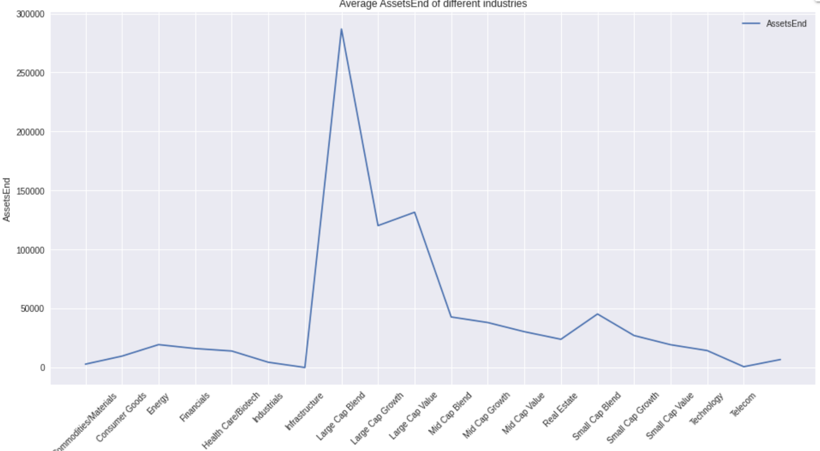
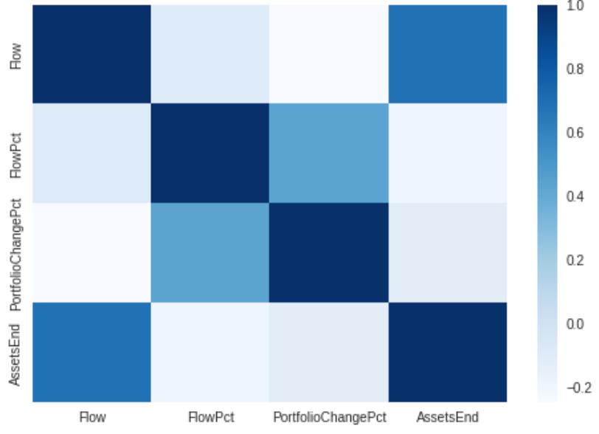
Features by Different Industries
Flow is Less Correlated with PortfolioChangePct
Flow
We can see that the correlation between Flow and AssetsEnd is large.
But the correlation between Flow and PortfolioChangePct is extremely small.
⇒ need to observe PortfolioChangePct
FlowPct
PortfolioChangePct
AssetsEnd

Slide 18
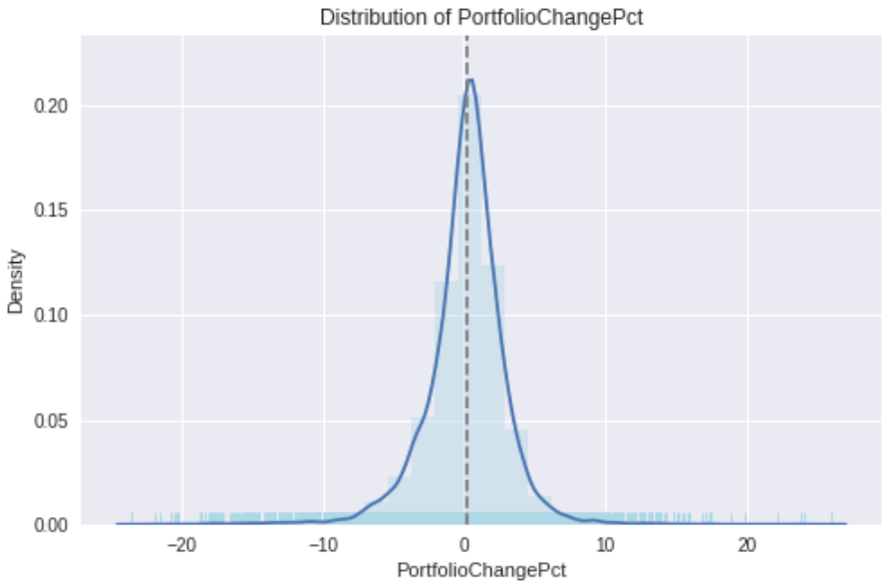
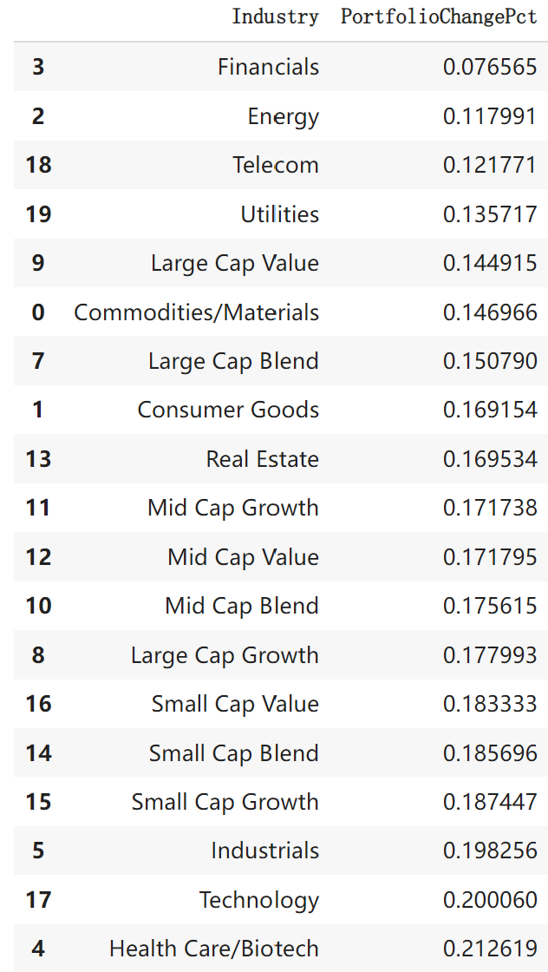
Average PortfolioChangePct among Different Industries
Financial & Energy Have the Smallest Ones
PortfolioChangePct is normally distributed and most concentrated in the range (-10, 10).
Smallest average PortfolioChangePct:
Financial & Energy → Stable → Cautious
Largest average PortfolioChangePct:
Health Care/Biotech & Technology → Risky → Open

Slide 19
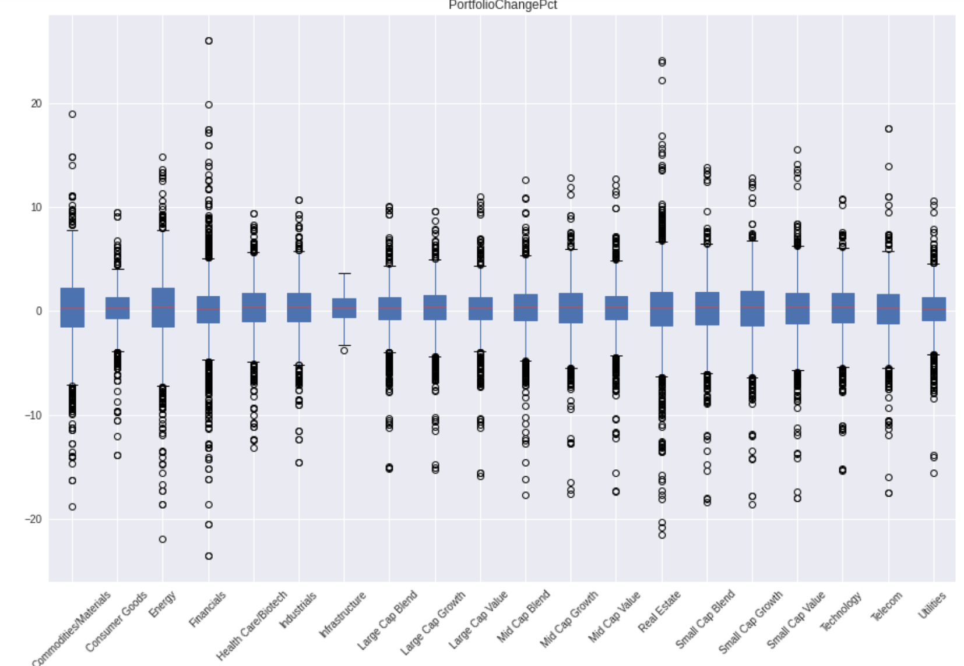
PortfolioChangePct Distribution of Different Industries
Decentralization Means Greater Possibility of Profit, Concentration Means Avoiding Huge Losses
4 most representative industries：Financial, Energy, Health Care/Biotech & Technology
Financial & Energy: the volatility is small but the distribution is the largest, which makes it easy for investors to gain profits :)
Health Care/Biotech & Technology: The volatility is high but at the same time the distribution is small, which means that even a drop will not bring huge losses :)

Slide 20
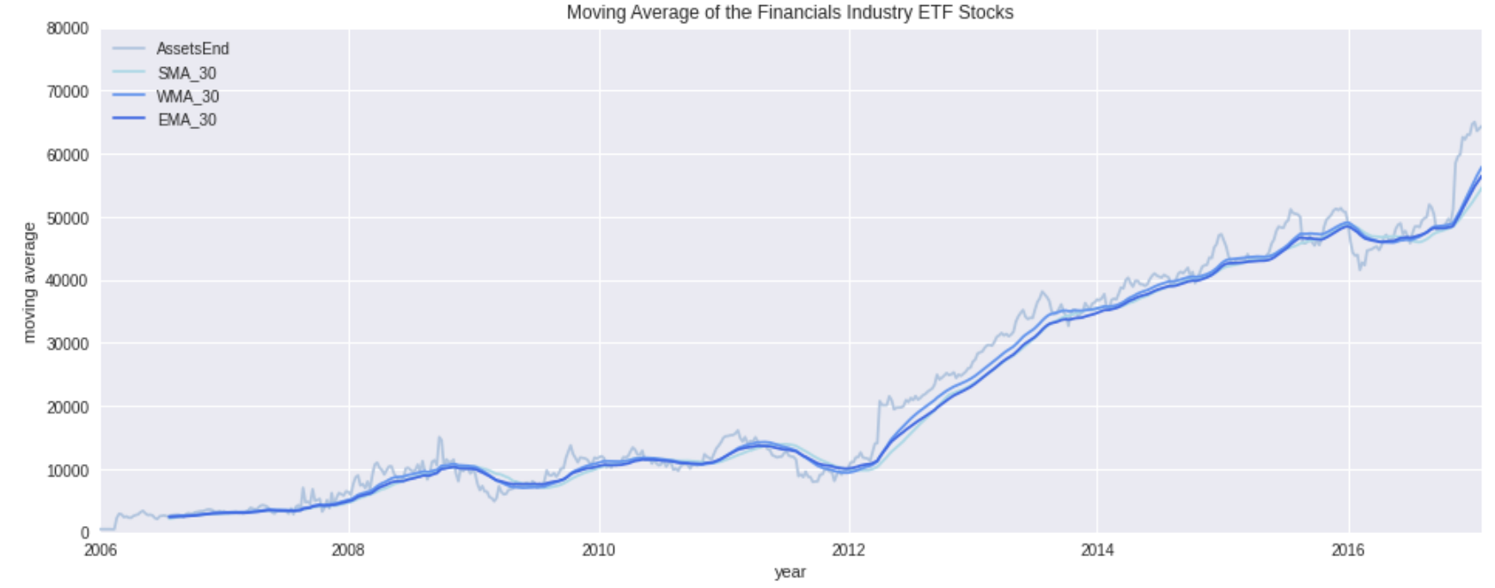
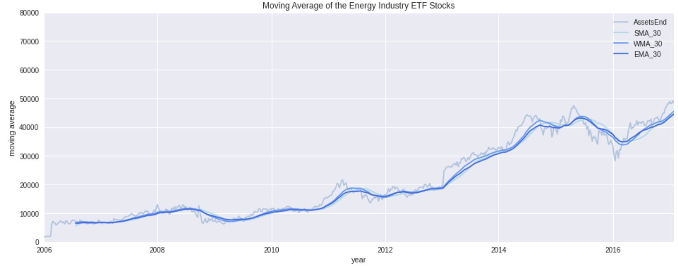
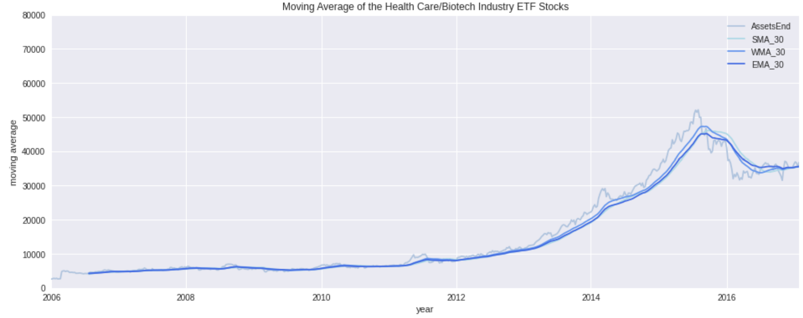
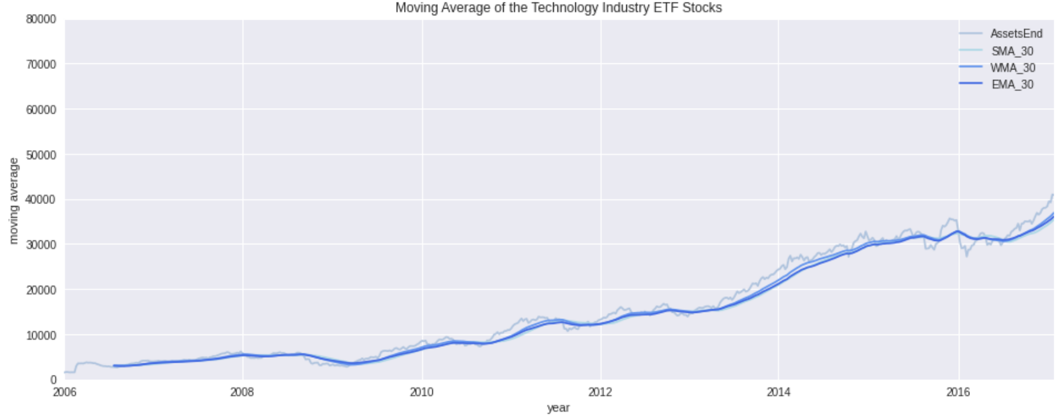
Moving Average of ETF Type
Smoothing Fluctuations for Time Series Forecasting
Financial
Energy
The chart below shows AssetsEnd data for 4 industry ETF funds along with a 30-week simple moving average.
Moving averages present us with long-term volatility trends.
Health Care/Biotech
Technology

Slide 21
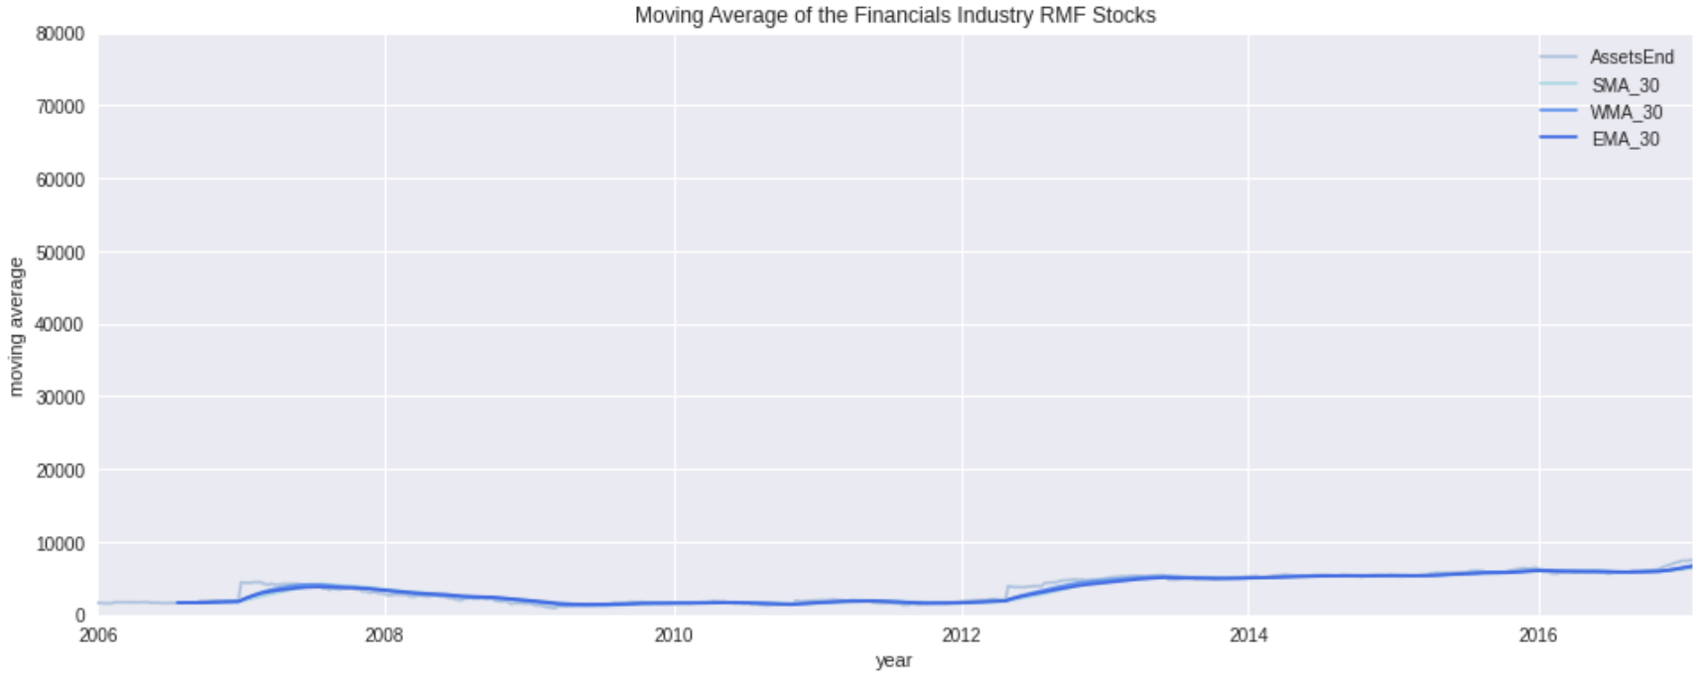
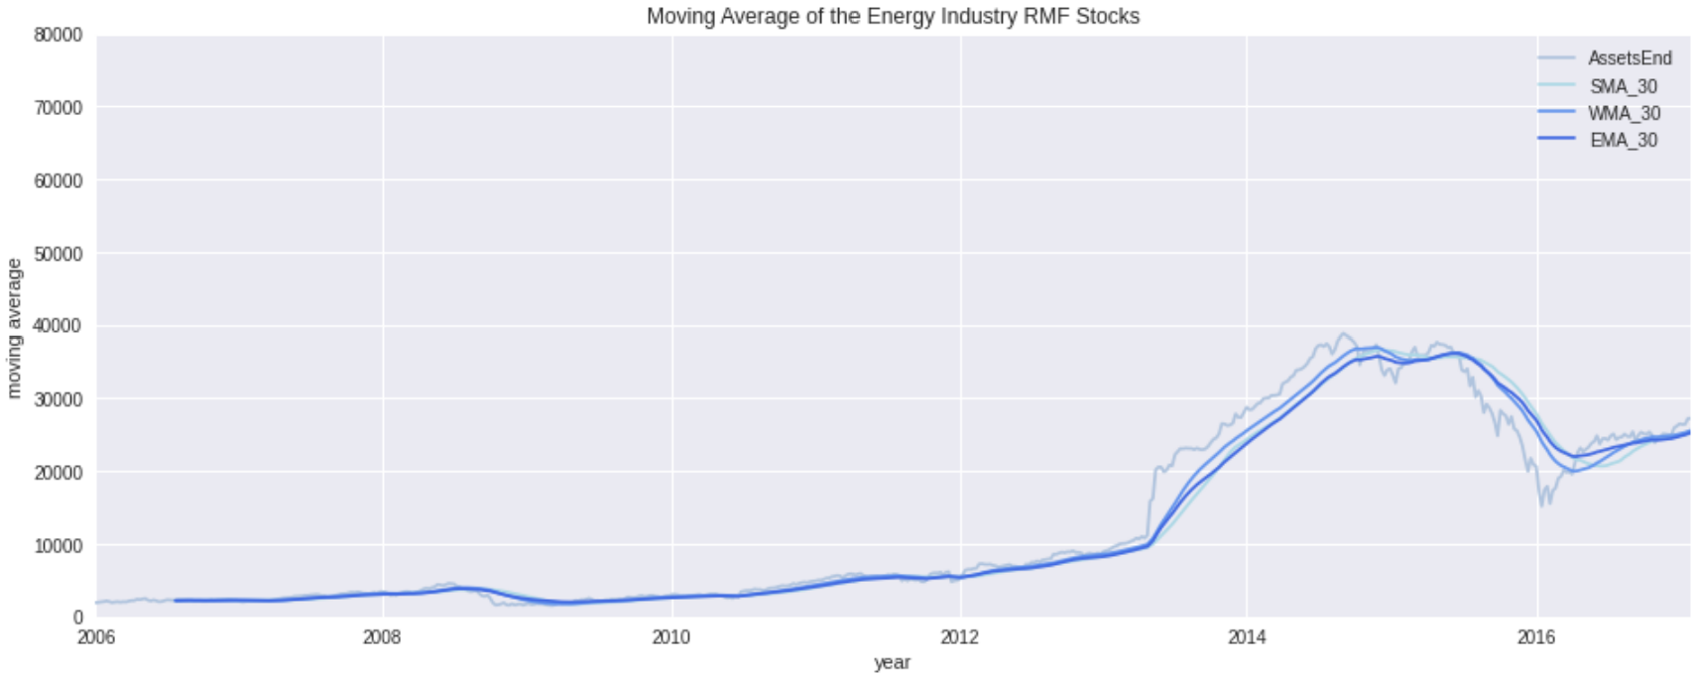
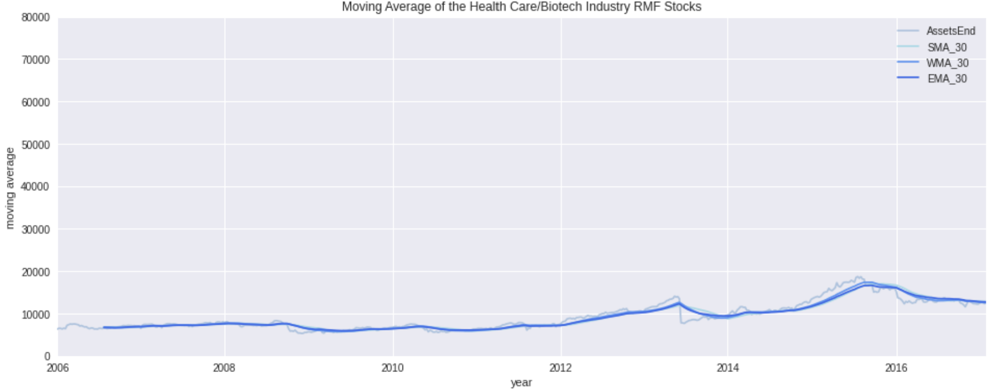
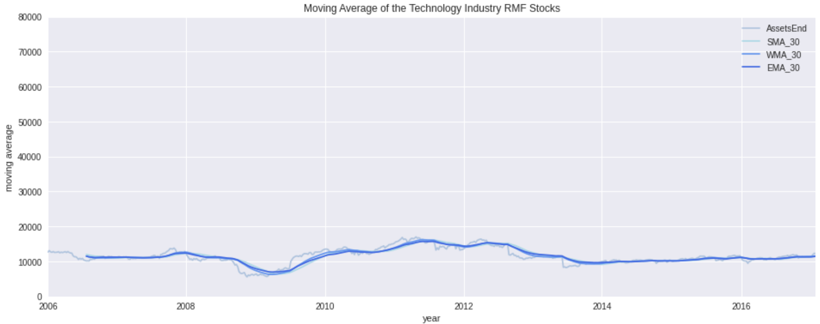
Moving Average of RMF Type
RMF-type Funds Have the Smallest and Smoothes Values
Financial
Energy
Overall, RMF-type funds have the smallest and smoothest AssetsEnd values.
And from an forecasting perspective, energy companies have the highest values of AssetsEnd.
Health Care/Biotech
Technology

Slide 22
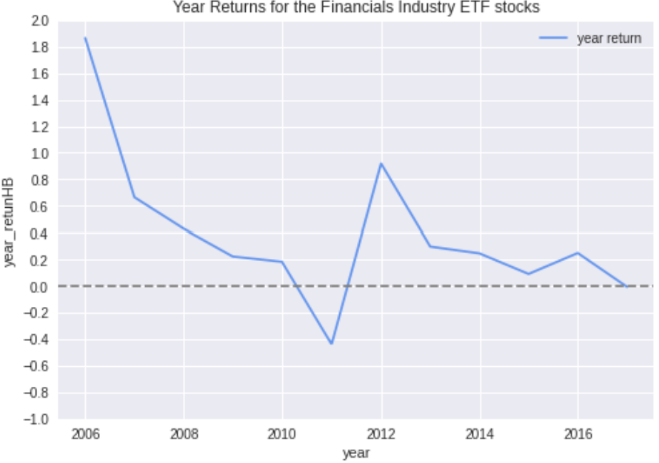
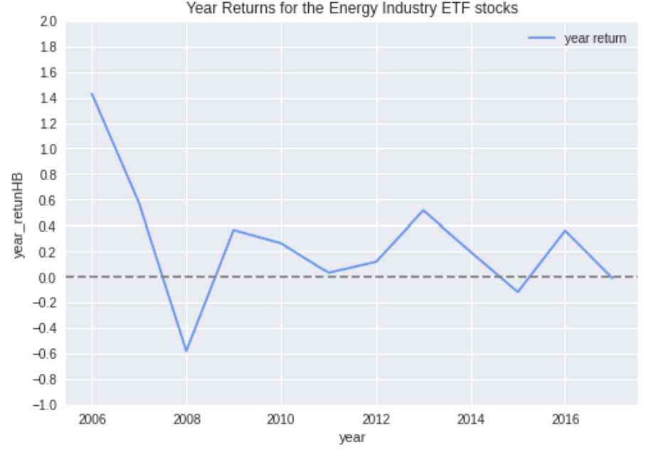
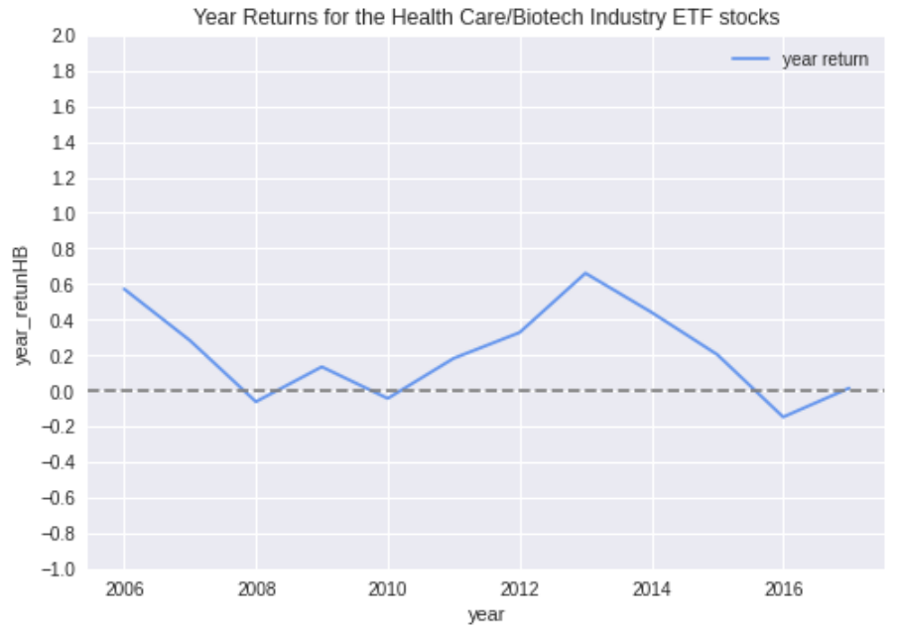
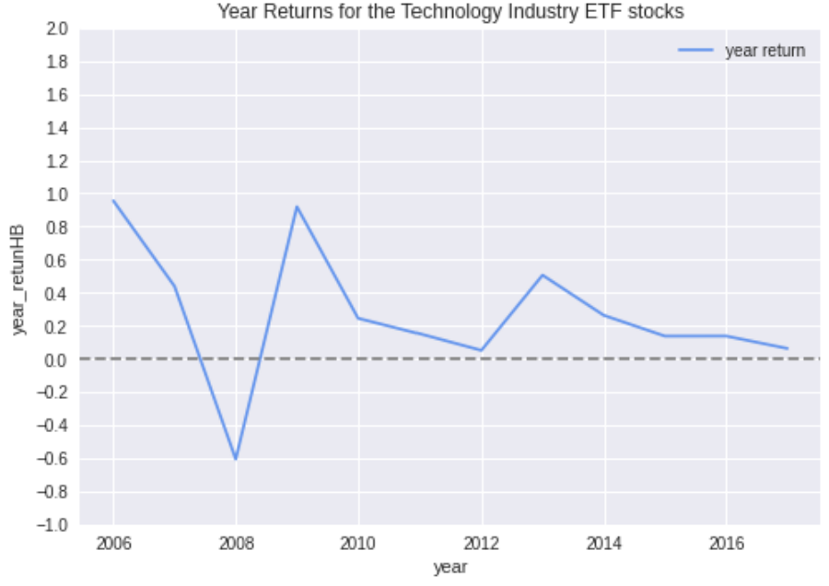
Fund Year Returns on ETF Type
Only the Health Care/Biotech Industry Shows an Increasing Trend
Financial
Energy
The Health Care/Biotech industry has the most stable annual returns.
Both 2013 and 2016 saw peak annual returns except for the Health Care/Biotech industry.
From the recent trend observation, only the annual rate of return of the Health Care/Biotech industry shows an increasing trend.
Health Care/Biotech
Technology

Slide 23
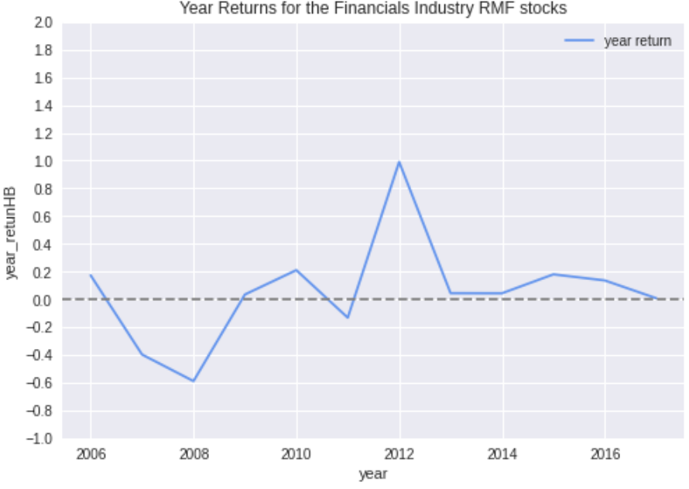
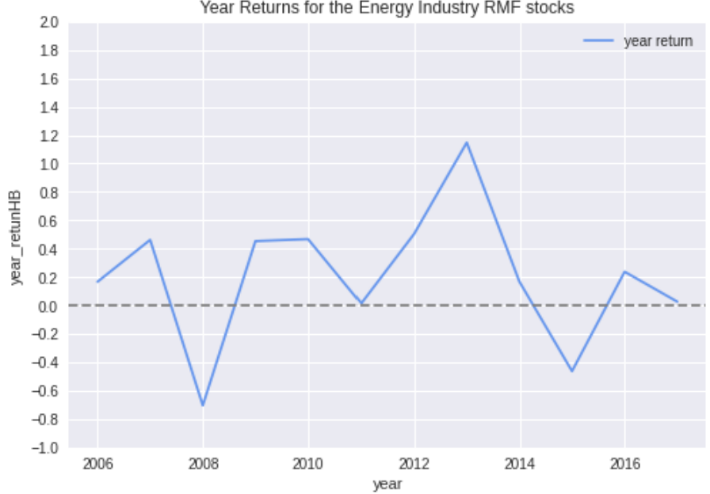
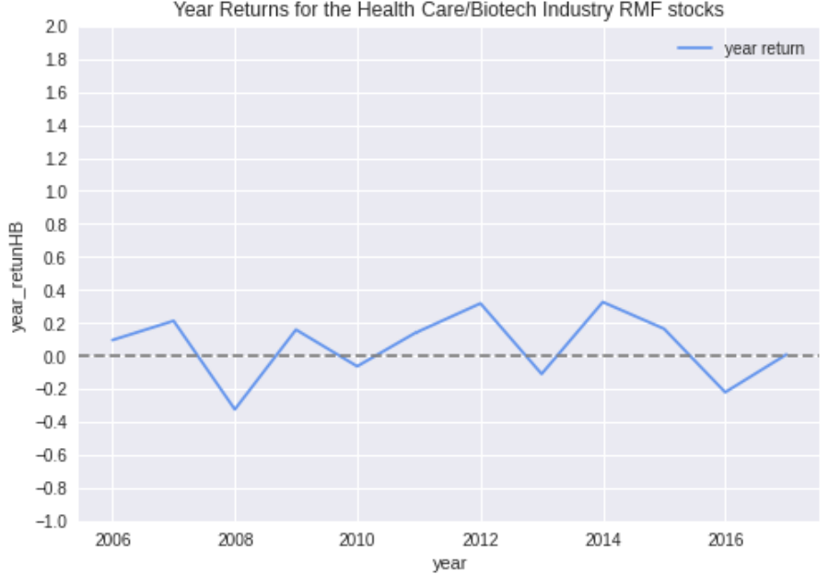
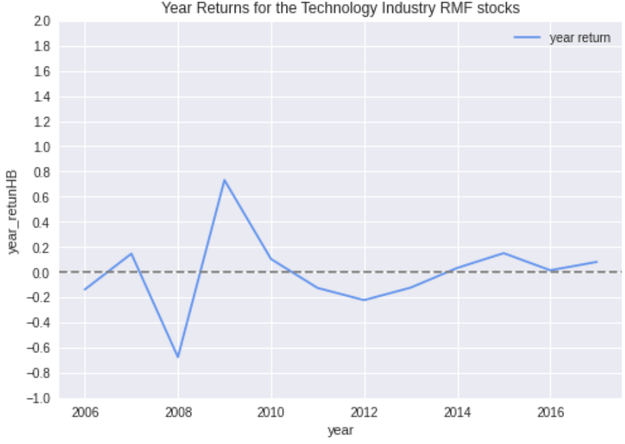
Fund Year Returns on RMF Type
Health Care/Biotech and Technology Industries Show an Upward Trend
Financial
Energy
The annual returns of RMF funds in the Financial and Energy industries are more volatile and show a downward trend in recent years.
The annual returns of RMF funds in the Health Care/Biotech and Technology industries have shown an upward trend.
Health Care/Biotech
Technology

Slide 24
Exploratory Data Analysis
Findings & Conclusion
Flow is highly correlated with AssetsEnd and Less correlated with PortfolioChangePct; More inflows in the second half of 2013 - 2017;
Financial & Energy: stable, easier to profit but the annual rate of return shows a downward trend↓ [Cautious investors];
Health Care/Biotech & Technology: risky, avoid huge losses, the annual rate of return↑ [Open investors];
AssetsEnd of IMF funds and ETF funds move almost the same, but the IMF is more volatile; There is no big difference between IMF fund annual returns and ETF returns;
RMF-type funds have the smallest and smoothest AssetsEnd values;
Funds in the same industry tend to have the similar trend and range in terms of Flow for IMF and ETF type;
Infrastructure of RMF type fund could probably be delisted (no need to forecast), while for the other two types we have a limited number of observations for model fitting.

Slide 25
04
Model
Options
Hypothesis & solution formulation

Slide 26
Model Options
We can predict the tradable signal in two ways:
Prediction by time series regression to predict what the act.
But it has limitations. Time series regression can only give rough predictions within a given time.
Hypothesis test: (stationarity test)
h0: non-stationary, ha: stationary
Models: MA, Exponential Smoothing, ARMA, LSTM
By using Multi-Class Classification Models to predict what is the range of the flow’s changes.
Models: KNN, LogisticRegression, RandomForest, Decision Tree, GBDT, AdaBoost, GaussianNB, LinearDiscriminantAnalysis, QuadraticDiscriminantAnalysis, SVM

Slide 27
Our Approach
Local Optimization
with
Time Series Analysis
Global Optimization
with
Multi-Class Classification
Generate model for each unique combination of industry and fund type for short-term forecasting
Compile a model that works for all sub-categories, can provide long-term prediction

Slide 28
05
Time Series Analysis
Studying the Characteristics of Flow wrt ReportDate

Slide 29
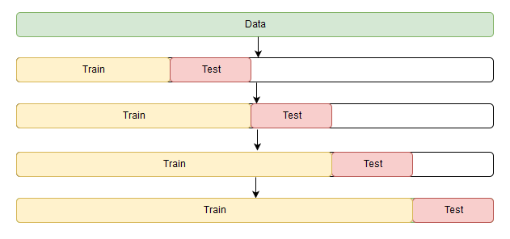
Time Series Analysis
General Design for All Models
Model Inputs/Predictors:
Past time-series data
ReportDate as independent variable
Flow as dependent variable
Target Variable:
Flow in the future
Validation Method:
Train test split
Training set: 1 ~ 550
Testing set: 551 ~ 579
Evaluation Metrics:
Visually: smoothness of the flow
Mathematically: MSE
Forward Chaining Schematic Diagram

Slide 30
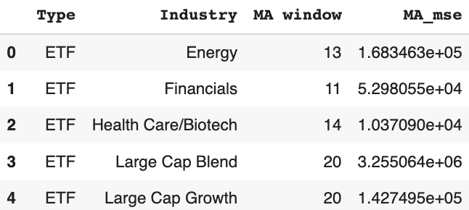
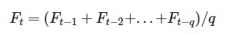
Moving Average
MA(q) model
“Window” selection - q:
Grid Search / Iteration to find the best performed one:
Initializing Moving Average estimations with window ranged from 1 to 20,
Find the corresponding window that returns the minimum MSE
Based on ACF plot:
Select lag index when coefficients begin to be not significant

Slide 31
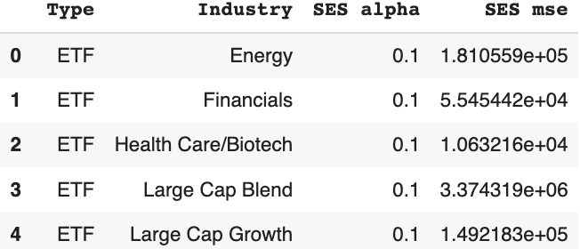
Simple
Exponential Smoothing
Smoothing level factor - α:
Ranges from 0 ~ 1
0: only the most recent values influence the forecast results
1: past observations generate a larger influence on forecast results
Grid Search / Iteration to find the best performed one:
Initializing SES estimations with alpha ranged from 0 to 1 with 0.1 step,
Find the corresponding alpha that returns the minimum MSE.

Slide 32
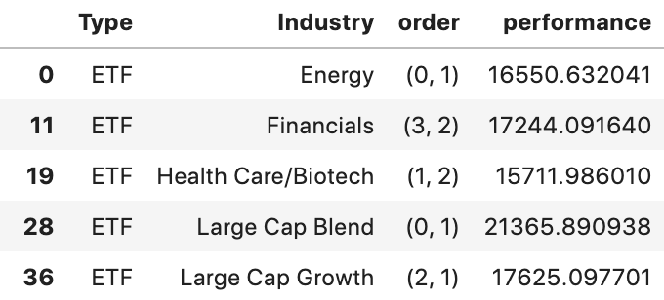
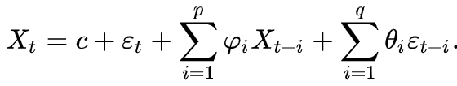
AutoRegressive
Moving Average
Formula:
Grid Search / Iteration to find the best performed order:
Lag Order: 0 ~ 4
Window order: 1 ~ 4
Performance Metrics:
Sum of AIC & BIC, the lower the better.

Slide 33
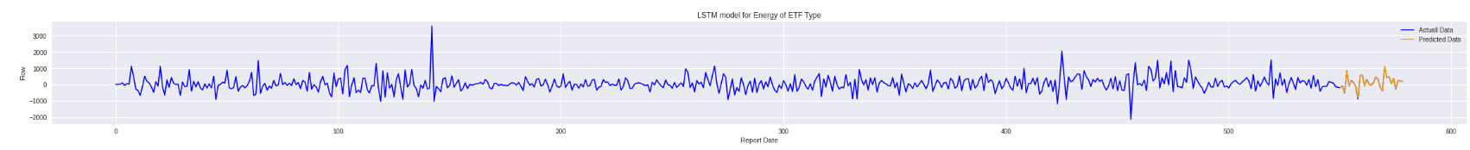
Long Short-Term Memory
LSTM Model
Can be applied to specific industry
Follow most of jump and down
Use the first 60 days of flowPct, AssetsEnd and PortfolioChangePct to predict flow
StandardScaler

Slide 34
Performance Evaluation
2 Year Forecasting on Energy Industry of ETF Type
Model | MAE | MSE
MA(13) | 410.30 | 1.683463e+05
ES(alpha = 0.1) | 425.51 | 1.810559e+05
ARMA(0, 1) | 408.61 | 1.669611e+05
LSTM | 0.01 | 0.00010

Slide 35
Time Series Forecasting
Conclusion
Advantages:
Simplicity, efficiency on short-term forecasting
Limitations:
The past of the time-series data does not generate enough power to predict the future
Three models (MA, SES, ARMA) include smoothing trends that offset the ups and downs of flow fluctuations
Multiple additional features should be taken into account to get a more accurate forecast
Notes:
Here we introduce with another approach:
Multi-class Classification on Percentage Change of Flow

Slide 36
06
Classification
Multi-Class Classification Models with Self-defined Tradable Signals

Slide 37
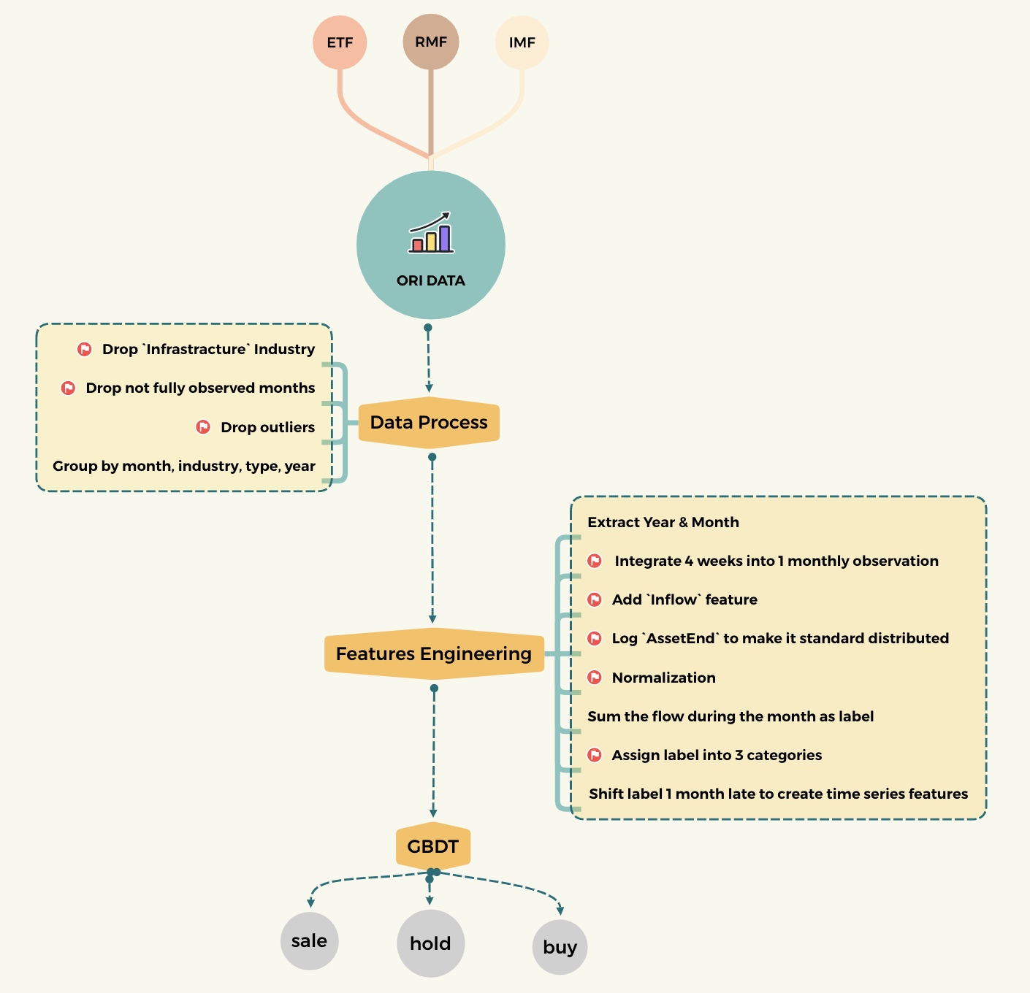

WorkFlow
The main idea of modeling at a glance
Main idea:
To predict which interval that the next month’s Flow will locate in, based on the indicators of this month.
Define the tradable signal:
Turn the monthly flow into categorical data:
The number of Flow located within (,-100) is 2589 (-1: sell)
The number of Flow located within [-100,100] is 2288 (0: hold)
The number of Flow located within (100,) is 2615 (1: buy)

Slide 38
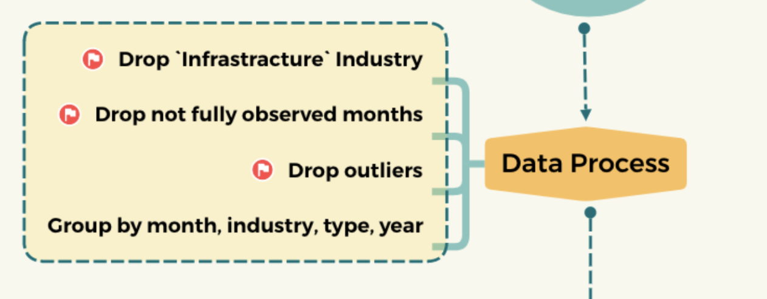
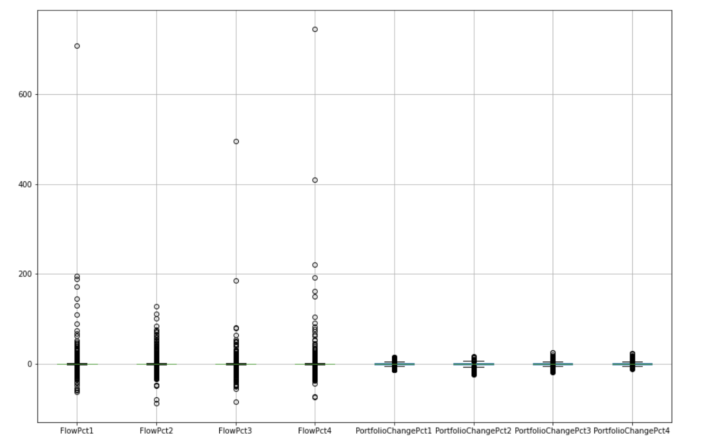
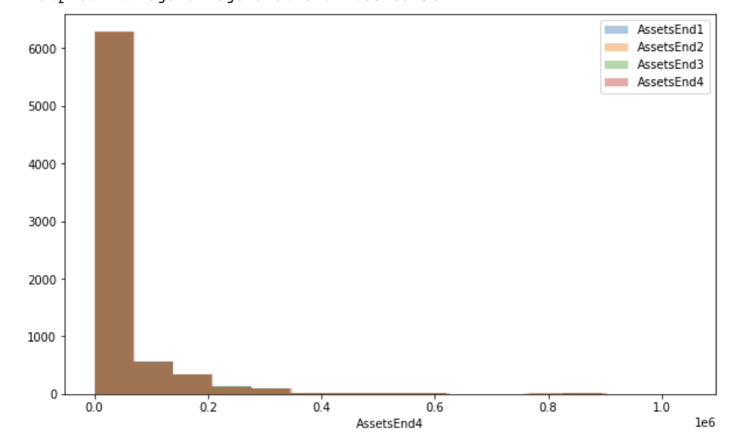
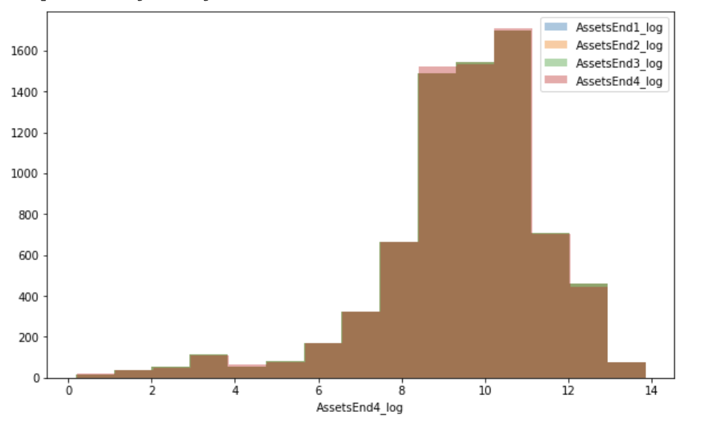
Data Processing
After the mid-term, we did extra in. . .
Check outliers of PlowPct & PorfolioChangePct
Distribution of AssetEnd
Distribution of AssetEnd after log

Slide 39
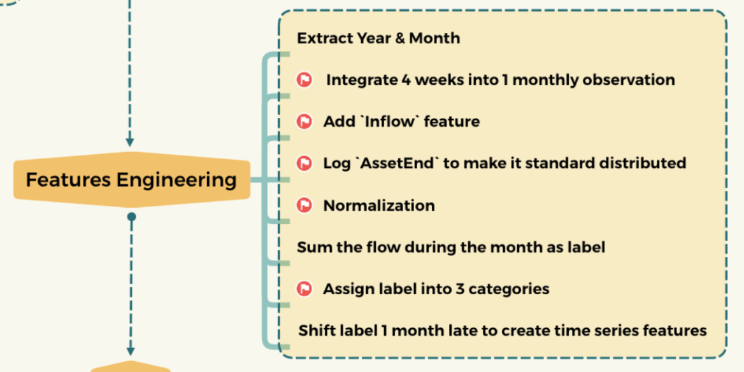

Features Engineering
After the mid-term, we did extra in. . .
Final Size of the data:
7493 rows × 11 columns
Sampling:
Split train and test into 80% and 20%

Slide 40
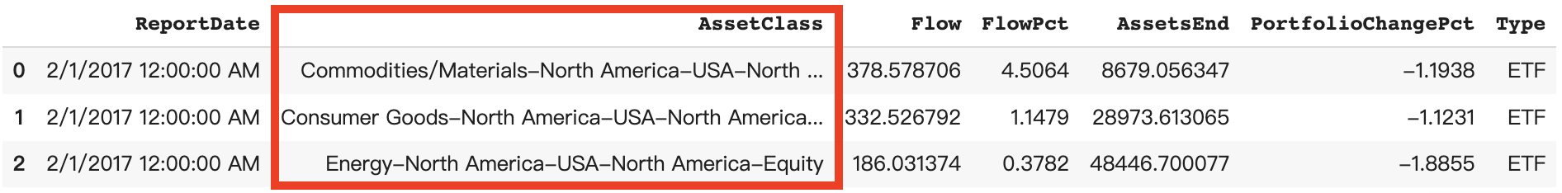
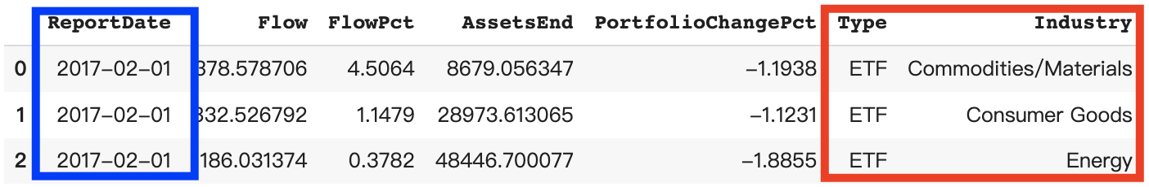
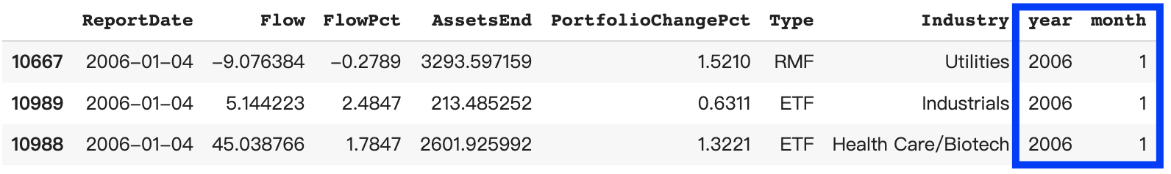
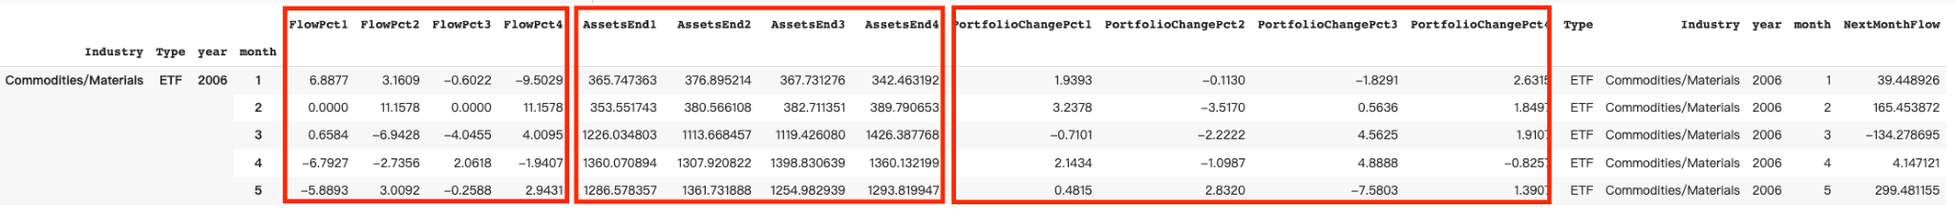
Features Engineering
32688 rows × 7 columns:
Contact 3 dataset
Process AssetClass
32688 rows × 7 columns: still
Drop Infrastructure industry
Drop not fully observed months
Drop outliers
Extract year and month
32564 rows × 9 columns:
Integrate into monthly observed
7493 rows × 11 columns
Notes:
More intuitively,

Slide 41

Correlation Heatmap
Focus on the correlation with the trading signal
Add more predictors
For example, the 2nd and 3rd week’s FlowPct, AssetsEnd and PortfolioChangePct in the month
The data are more powerful in predicting the tradable signal

Slide 42


Model Evaluation
Comparing with the mid-term
Best Model in Midterm
Fit the data into 10 classifiers from sklearn module
BEST classifier: GBDT
Comparing with midterm, the Final model has increased 25% in the overall accuracy
Precision on “Sell” is increased 3.2%
Precision on “Hold” is increased 48%
Precision on “Buy” is increased 23%
Best Model in Final

Slide 43
Multi-class Classification
Conclusion
One advantage of classification is we can give a global optimization using only one model.
Limitations:
We did not consider the currency value has changed during the past 10 years. Change the trading signal as ratios might be a solution.
More features are needed to show the performance of the stock, from which the model can capture more information.

Slide 44
07
Use-Case
Scenario
How our models help

Slide 45

Business Application
Time Series Analysis
With our Time Series Analysis:
We are able to find funds which are more stable in flow amount, less volatile to market, and less sensitive to time; these funds are concluded to be the safety choice to invest.
Asset managers can use our findings to classify funds (stable/volatile)
Based on the MSE output, LSTM gives the highest accuracy on forecasting near future Flow value.
With our forecast on future funds’ value, we can give clients’ suggestions on whether to invest when flow decreases, whether to sell on-hand type when flow increases.

Slide 46
Business Application
Classification Analysis
With our Classification Analysis:
Help clients predict the specific Flow range for the future month.
Help clients choose a fund in the ideal Flow range.
Forecast the trend of fund market fluctuation.

Slide 47


Business Application
Buy & Sell

Slide 48
THANKS
Any questions?

Slide 49
Appendix
Additional Materials/Findings of our project

Slide 50


Commodities/Materials Industry
IMF and ETF Share Similar Pattern in terms of Flow
We can observe a very similar pattern of flow rises and drops;
Not only did the changes happen at the same time, but the magnitudes of increases or decreases were roughly the same.

Slide 51



Industrials Industry
Have only 5 years of RMF Records
RMF type of fund has a later beginning than the other two:
First record is on “2011-10-19”,
While the other two is on “2006-01-04”.
Meaning we have only about 5 years of RMF records, which is half less than ETF or IMF.
Difference in weeks between first record of types match with number of missing value.
There is no other discontinuity exists

Slide 52


Industrials Industry
IMF and ETF Share Similar Pattern in terms of Flow
We can observe a very similar pattern of flow rises and drops;
Not only did the changes happen at the same time, but the magnitudes of increases or decreases were roughly the same.

Slide 53




Moving Average of IMF Type
Volatility is a Little Bit Larger than that of ETF
Financial
Energy
In general, the trend is almost the same as that of ETF funds AssetsEnd.
But all the volatility is a little bit larger than that of ETF.
Health Care/Biotech
Technology

Slide 54




Fund Year Returns on IMF Type
No Big Difference Compare with the ETF Type
Financial
Energy
There is no big difference between IMF fund annual returns and ETF returns.
Health Care/Biotech
Technology

Slide 55
Time Series Analysis
Basic Properties
Trend:
Refers to a long-term increase or decrease in the time-series data
Can be a roughly slope going through the data
Seasonality:
Refers to periodic fluctuations.
If there exists repeated pattern, we can intuitively observe the length of the interval from the line chart of flow by time.
Cyclicity:
Refers to (regular or periodic) fluctuations around the trend, excluding the irregular component, revealing a succession of phases of expansion and contraction.

Slide 56

Time Series Analysis
Relationship between current value and past
Autocorrelation:
Refers to the similarity between observations as a function of the time lag between them.
We can also derive the inference about seasonality from autocorrelation plots.
1 spike outside the blue region, meaning that there is correlation at lag 1.
Difficult to identify a seasonality, because increases and decreases are not showing a clear pattern of same interval.

Slide 57

Time Series Analysis
The Golden Rule
Stationarity:
Check whether statistical properties such as mean, variance, and covariance do not vary with time.
Why Important: stationarity is the pre-requirement of a time-series data continuing to “inertia” along the existing form in a further period, thus, it is the precondition for predictable.
Each subset is proved to be stationary through the the ad-fuller test, with this as a premise, we can move on with MA, SES and ARMA estimations.

Slide 58
Time Series Analysis
Models From Simple to Complex
Moving Average:
States that the next observation is the mean of all past observations.
A smoothed flow line with highlighted different trends.
Exponential Smoothing:
Different weights are assigned to different observations: the more recent, the more important,
ARMA:
AR: Autoregression. A model that uses the dependent relationship between an observation and some number of lagged observations.
MA: Moving Average. A model that uses the dependency between an observation and a residual error from a moving average model applied to lagged observations.

Slide 59

Time Series Analysis
Models From Simple to Complex Cont.
4. LSTM:
Long Short Term Memory networks are a special kind of RNN, capable of learning long-term dependencies.
Frequently in used for Time-Series Prediction
LSTMs can be used where ever there is time dependent information.
(To be precise wherever there is sequence data)

Slide 60


Assess MA* vs SES*
MA Returns smaller MSE when the window value is larger:
Underlying pattern of flow is stable
SES returns smaller MSE when smoothing trend is smaller:
Flow forecast is less sensitive
For most local optimization approaches:
MA performed better than SES

